Slide 1
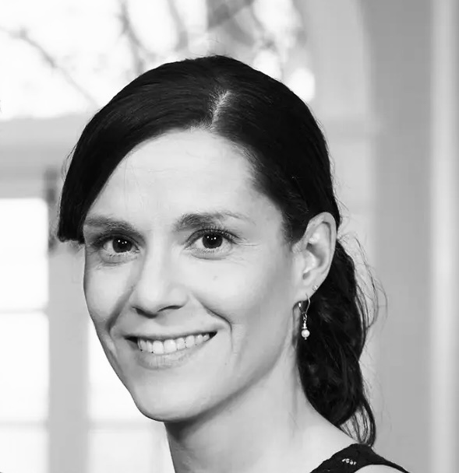
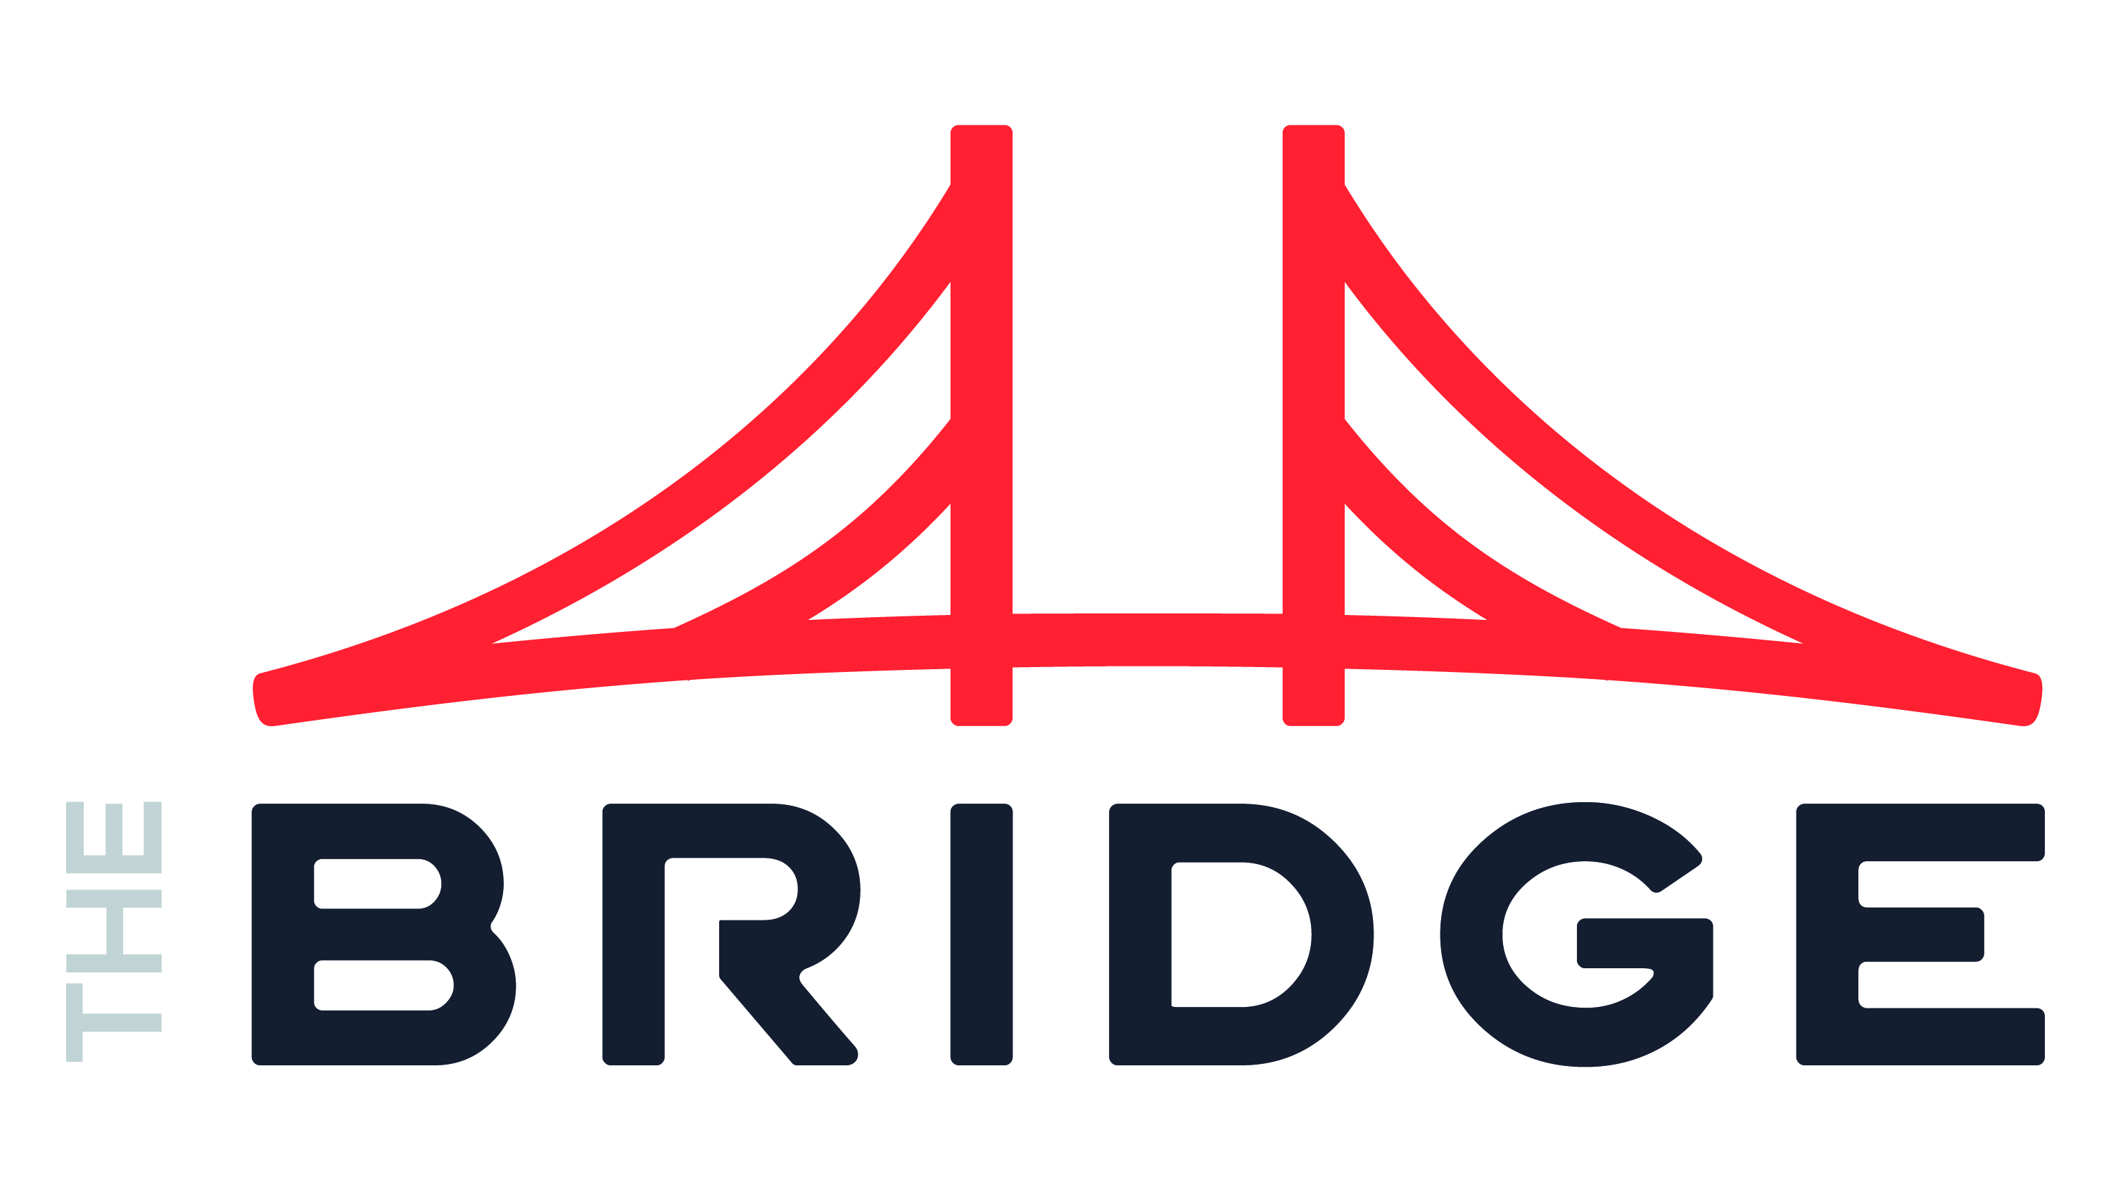
Ashley Clinthorne Data & AI
INDUSTRIES
Industry Experience
Retail | Healthcare | Government and Public Sector | Education | Manufacturing | Insurance | Banking
EXPERIENCE
Retention Modeling | Retail
Problem: Client was experiencing high levels of employee attrition and wanted to understand the drivers of employee turnover across the organization.
Value: Understanding attrition risk allows the client to proactively target high value employees for retention conversations and develop retention strategies targets at key demographics. This reduced employee turnover proving the organization with significant cost savings and improved employee satisfaction.
Tools: Python, Redshift
Role: Functioned as the project lead including gathering requirements, data cleaning, feature engineering, model building and presenting results and recommended actions to leadership
Stochastic Risk Model | Insurance
Problem: Due to changing government regulations, the client needs to update and fully document their financial risk models.
Value: Used a sophisticated simulation models for severity and prevalence of claims, we combined findings with additional measures for capital risk and reputation risk. Efforts improved the clients capital allocation and their ability to mitigate potential financial shocks.
Tools: R, SQL Server
Role: Functioned as lead data practitioner including understanding existing state, developing and implementing new models, and presenting models to the board
BACKGROUND
Functional Skills
Data Science | Advanced Analytics | AI | Machine Learning | Data Strategy | Data Engineering | Data Analysis and Visualization
Qualifications:
As an experienced data and analytics professional, Ashley has implemented solutions across industries including retail, healthcare and technology. Ashley specializes in using advanced techniques to create actionable insights to drive decision making across organizations.
BIO & CONTACT INFO
Email
Ashley.Clinthorne@thebridge.com
Mobile
(440) 554-6289
Location
Denver, Colorado
Ashley has over 10 years of experience in Data Science and Analytics across a wide range of industries. Her specialty is using data to solve problems and generate insights whether it is simple dashboards to complex machine learning and AI.

